Slide 1
Defensive Security Project
by: Andrew Johnson, Cade Simcox, Stephanie Ortega, Sean Hurley, Vincent Kruis, James Nguyen

Slide 2
Table of Contents
This document contains the following resources:
Monitoring Environment
Attack Analysis
Project Summary & Future Mitigations

Slide 3

Monitoring Environment
‹#›

Slide 4
Scenario
Virtual Space Industries (VSI) contracted us as a SOC based on rumors of an attack by the competitor JobeCorp.
We were given normal conditions for VSI to establish baseline activities and create thresholds for potential attacks.
Using the data VSI provided we were able to monitor a cybersecurity attack on their Windows and Apache servers.
We were also given the attack logs which we used to analyze the attack

Slide 5
Website Monitoring App
‹#›

Slide 6
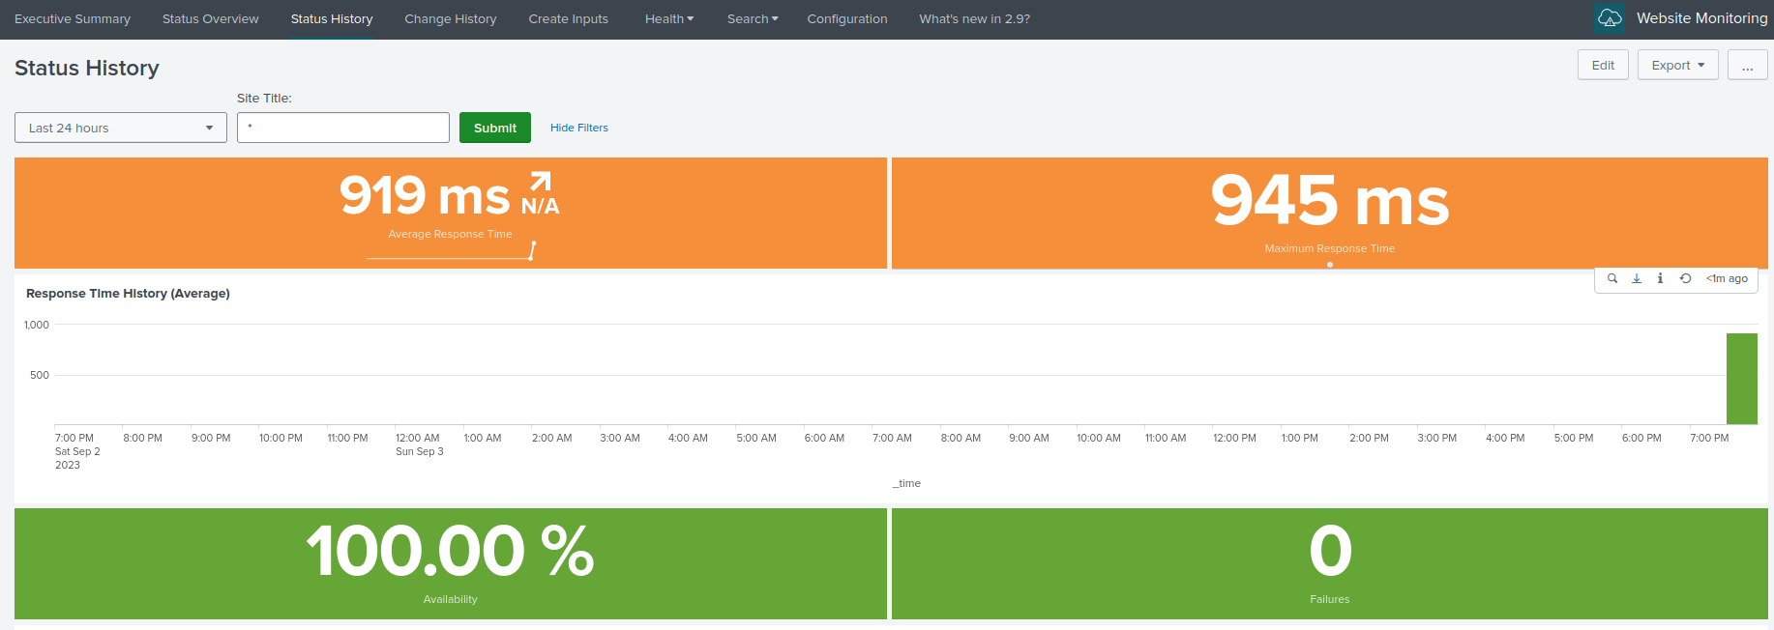
Website Monitoring
This app monitors a website (URL inserted into a modular input) to detect downtime and performance problems. The add-on collects relevant data from websites / web applications like response times, server health, and error rates. It has pre-configured dashboards & visualizations for these values.

Slide 7
Website Monitoring
Who benefits from Website Monitoring add-on app
Business websites, getting performance data on your website or web app is important because you want to make sure your website is healthy and clients are able to access it.
SLA compliance

Slide 8
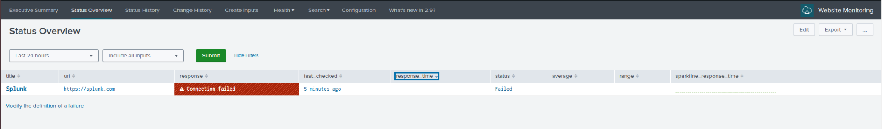
Website Monitoring
We can put inputs into the website monitoring add on which has many settings and fields that you can use to track more specifically what data you want to see. Here I used simply the default fields on the splunk url. This add on had many features such as dashboards,

Slide 9
Logs Analyzed
Windows Logs
Apache Logs
1
2
Account names
Account domain
User account controls
Privileges
Password attributes
Changed attributes
Log on information
Security ID
Process ID and Name
Service Request Information
Service Name
HTTP status code
HTTP request type
IP address of device making request
Date and time of request
Size of response in bytes
URL of page linked to request
Browser information of user

Slide 10
Windows Logs
‹#›

Slide 11
Reports—Windows
Designed the following reports:
Report Name | Report Description
Signature and ID | Shows the ID number of a given signature
Severity | Gives an idea of the severity outlook
Status | Shows the success and failure status
User Count | Shows count of users and their logins

Slide 12
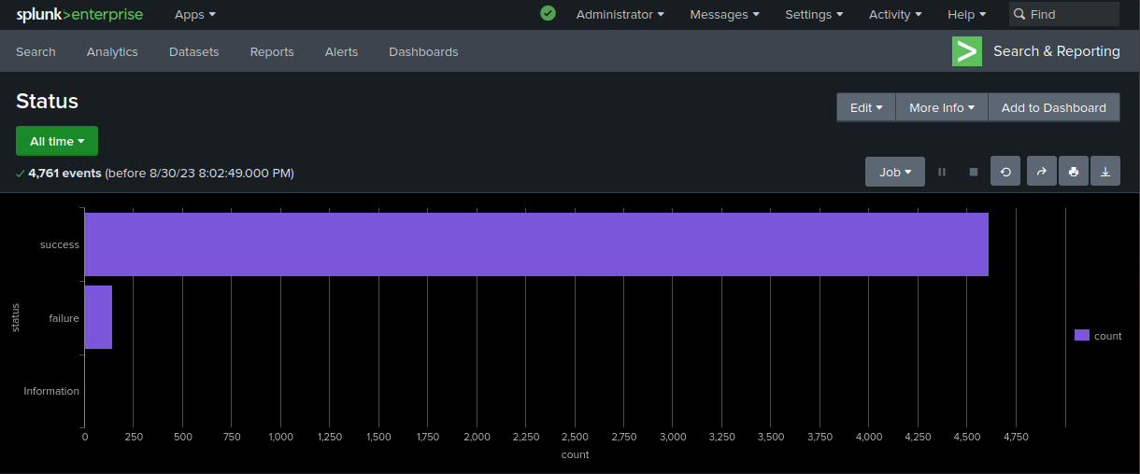
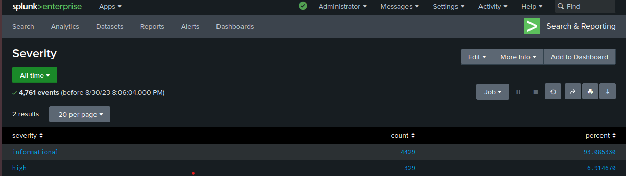
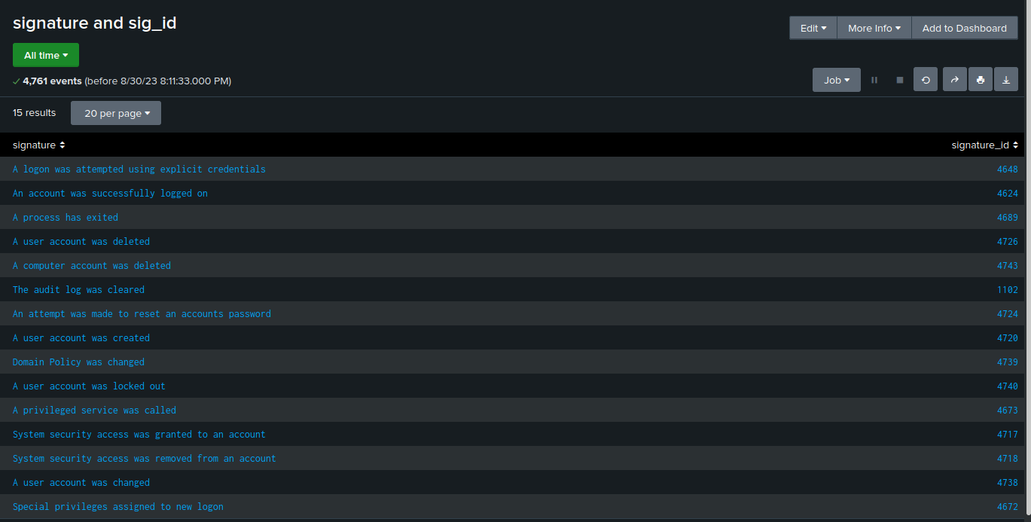
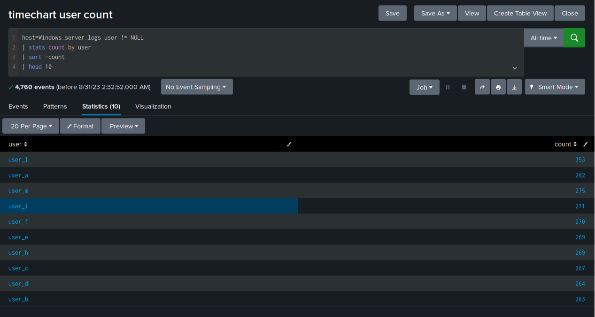
Images of Reports—Windows
Report Image
Report Image
Report Image
Report Image

Slide 13
Alerts—Windows
Designed the following alerts:
Alert Name | Alert Description | Alert Baseline | Alert Threshold
Suspicious Activity | Looks at the number of failed status | 7-8 per hour | 15 per hour
JUSTIFICATION: Based on the column chart normal hourly activity is 5 failure status plus or minus around 2-3. Therefore, A high baseline would be 8. Doubling the high base line gave me the threshold of 15 per hour.

Slide 14
Alerts—Windows
Designed the following alerts:
Alert Name | Alert Description | Alert Baseline | Alert Threshold
Successful Login | Counts the hourly number of successfully logins | around 15 per hour | 40 per hour
JUSTIFICATION: The majority of successful logins per hour was around 15 which was what I determined was a baseline. The highest number of successful logins was 21 which I doubled and rounded down to get a threshold of 40 per hour.

Slide 15
Alerts—Windows
Designed the following alerts:
Alert Name | Alert Description | Alert Baseline | Alert Threshold
Signature ID 4726 | An event that pertains to a user account being deleted | [11] | [17]
JUSTIFICATION: [Account deletion happened between 7-22 times and with most of them happening around 9-11 times. The highest being 22, so we set our alerts at 11 and 17.]

Slide 16
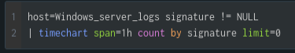
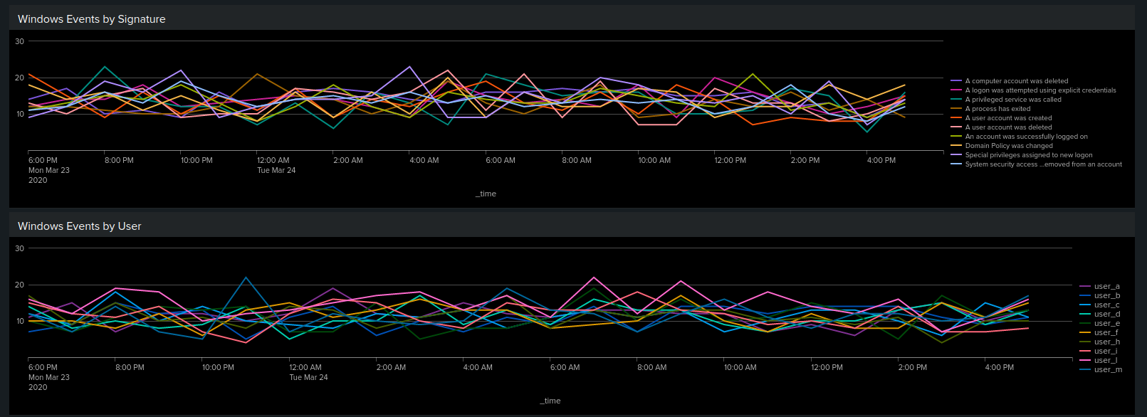
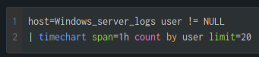
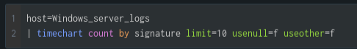
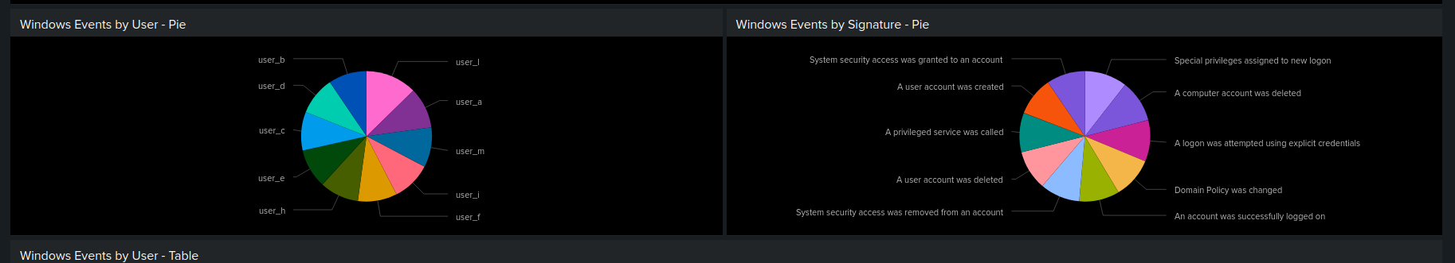
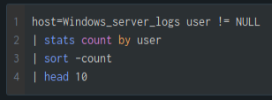
Dashboards—Windows
Place image here
Place image here
Place image here
Place image here

Slide 17
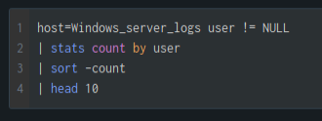
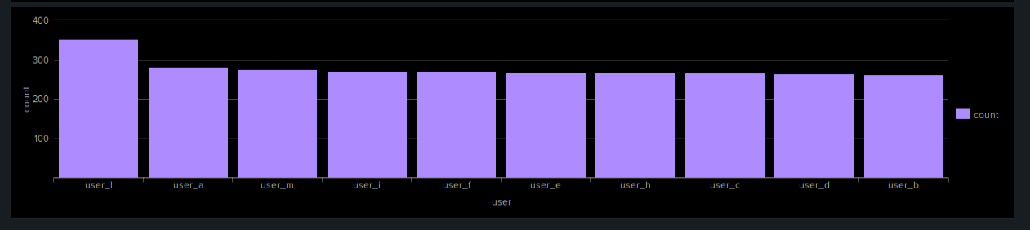
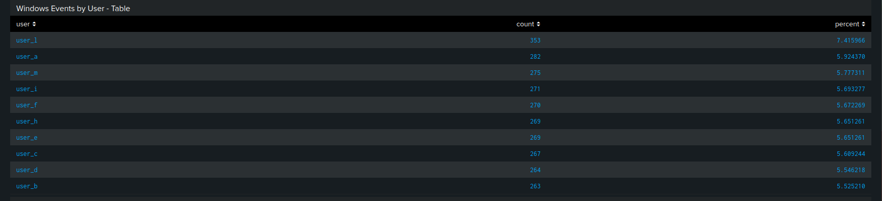
Dashboards—Windows
Place image here
Place image here

Slide 18
Apache Logs
‹#›

Slide 19
Reports—Apache
Designed the following reports:
Report Name | Report Description
HTTP Methods | Gives insight into the different HTTP request activity against the web server.
HTTP Response Code Count | Shows any abnormal counts of HTTP responses.
Top 10 Domains | This report shows the top 10 domains that referred to the VSI website.

Slide 20
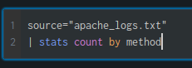
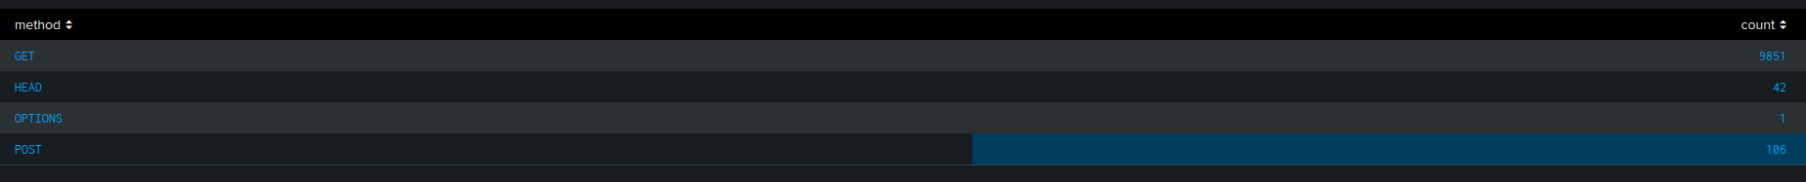
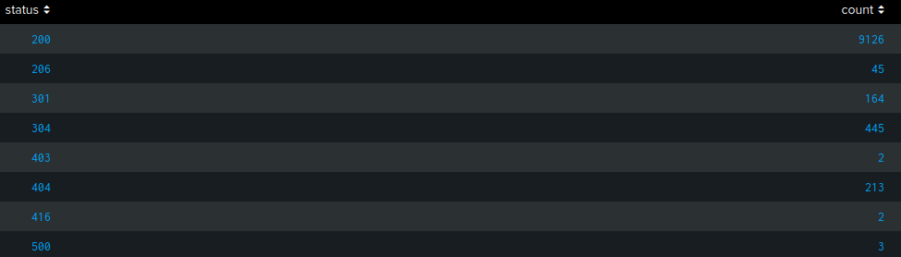
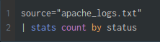
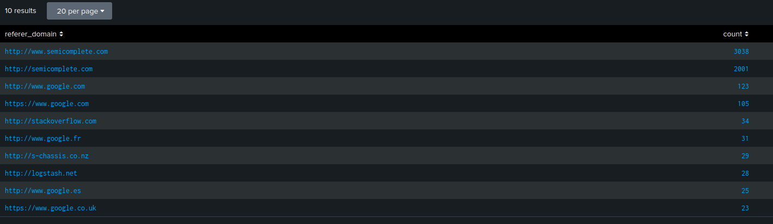
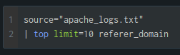
Images of Reports—Apache

Slide 21
Alerts—Apache
Designed the following alerts:
Alert Name | Alert Description | Alert Baseline | Alert Threshold
HTTP POST Count | Counts the number of HTTP POST requests. | 0-8 per hour | <10 per hour
JUSTIFICATION: After analyzing the linear timeline on apache_logs.txt, it was determined that there was a normal range of anywhere between 0 and 8 events in a given hour, by setting the threshold to 10 we can assume that anything at or above would be considered irregular activity.

Slide 22
Alerts—Apache
Designed the following alerts:
Alert Name | Alert Description | Alert Baseline | Alert Threshold
Hourly Activity Outside US | Counts hourly activity from a country other than the United States. | 60-120 per hour | <150 per hour
JUSTIFICATION: After analyzing the linear timeline on apache_logs.txt, it was determined that the average activity per hour was anywhere from 60-120. Allowing for a slight variance in activity, the alert threshold was established at 150 to trigger any abnormal activity above that value.

Slide 23
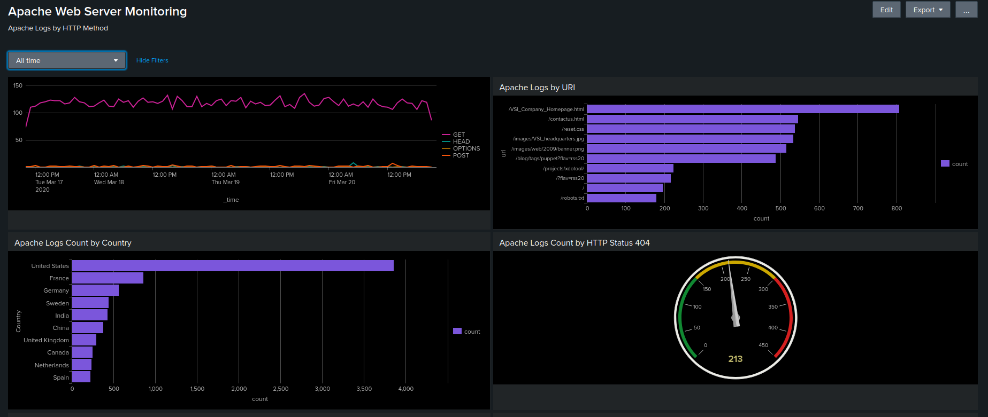
Dashboards—Apache

Slide 24
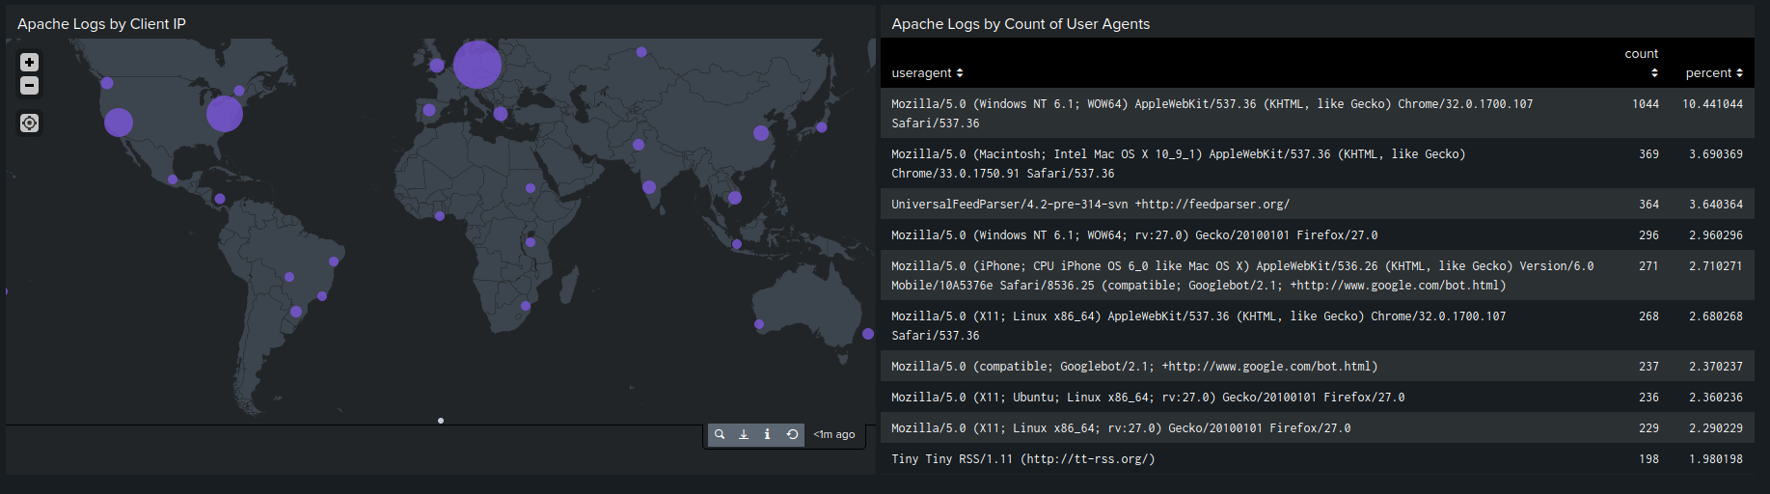
Dashboards—Apache (continued)

Slide 25
Attack Analysis
‹#›

Slide 26
Attack Summary—Windows
Summarize your findings from your reports when analyzing the attack logs.
The percentage of events with a high severity flag went from 6.9% to 20.2%
The ratio of failed action to successful ones surprisingly decreased from 0.03 on the 24 to 0.0158 on the 25 (Day of the Attack)
The number of events in general on the 25 did increase by 1189

Slide 27
Attack Summary—Windows
Summarize your findings from your alerts when analyzing the attack logs. Were the thresholds correct?
The Alert for failed windows activities was set for 15 in an hour, this would trigger at 8 am on the 25th with 70 failed activities
Alert for successful logins was set for 40, this alert would trigger at 11:00 am when there were 392 successful logins
Alert for deleted user accounts was set for 40, this alert would not have been triggered

Slide 28
Attack Summary—Windows
Summarize your findings from your dashboards when analyzing the attack logs.
There was a spike in events where an attempt was made to lock a user account from 12:00 am to 3:00 am on the 25th
suspicious amount of attempts to reset account passwords were made from 8:00 am to 11:00 am on the 25th
suspiciously high user activity was reported from user_a, user_k, and user_j
The timecharts for users activities and windows activities line up to show that user_a was locking account, user_k was attempting to reset account passwords, and user_j was logging in to user accounts at a suspicious rate.

Slide 29
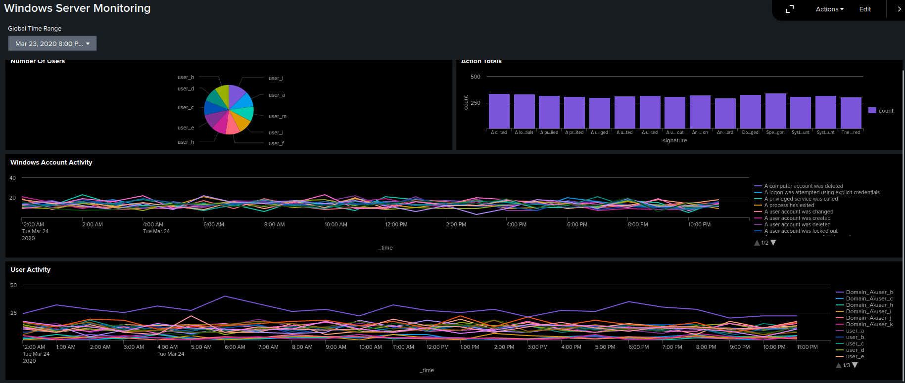
Attack Dashboard Screenshots 24th

Slide 30
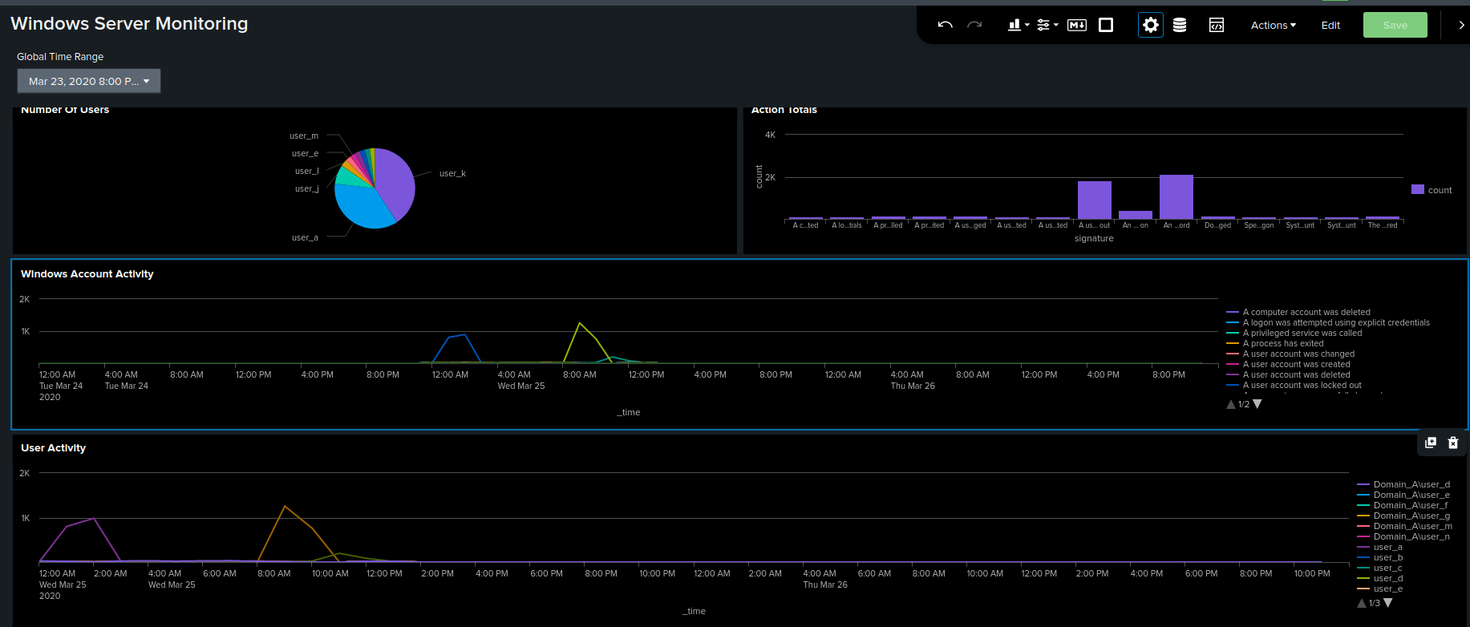
Windows DashBoard Day of Attack

Slide 31
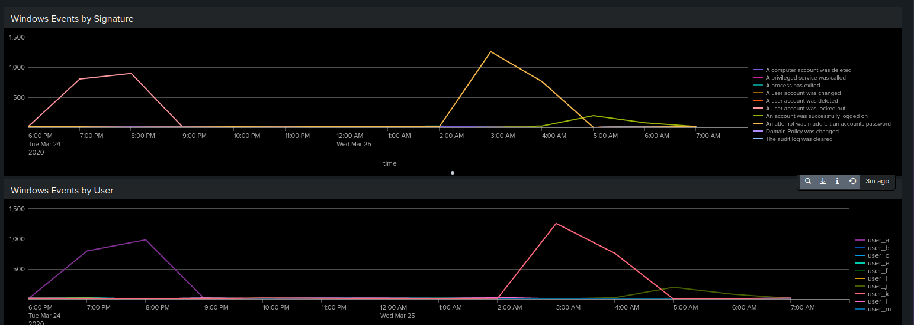
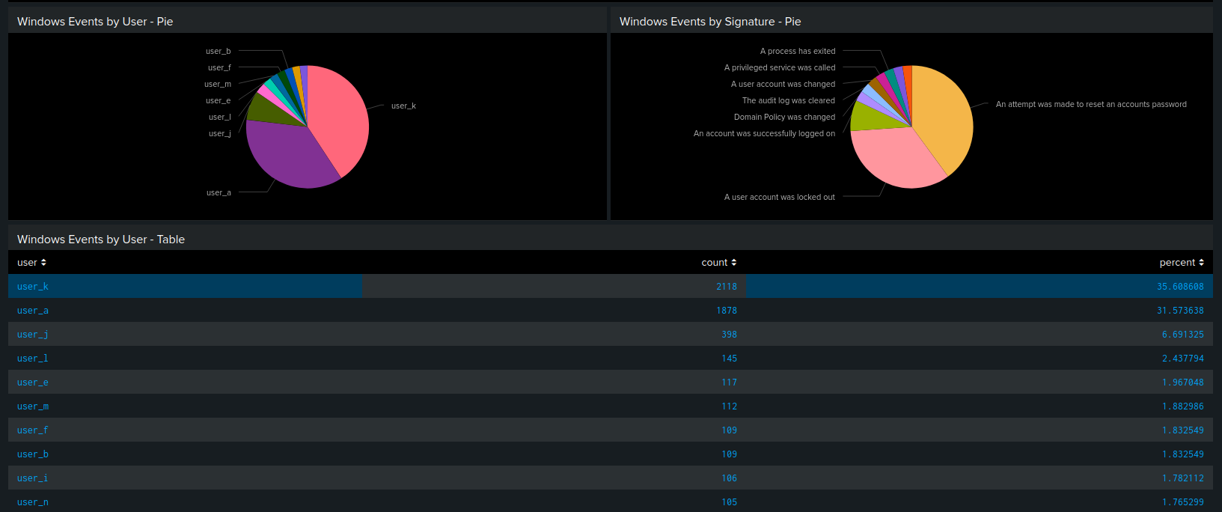
Screenshots of Attack Logs

Slide 32
Attack Summary—Apache (Reports)
Post requests (ex: logging onto a website, making a comment, uploading a document) increased from 1% of HTTP methods used to 29.4%.
404 response codes increased from 2.1% of requests to 15% of requests.
304 responses went down from 4.45% to 0.8%
There was no significant difference in the referrer domains used.

Slide 33
Attack Summary—Apache (Alerts)
There was a suspicious spike in international traffic around 8:00PM that would’ve set off our alert. There is no need to change the threshold since activity for the rest of the day was within the established baseline.
Also at 8:00PM HTTP POST request activity spiked to 1,296 requests in an hour. There is no need to change the threshold of 10 requests in an hour as the activity for the rest of the day was within the set baseline of 0-8 requests an hour.

Slide 34
Attack Summary—Apache (Dashboards)
The number of GET requests to the server spikes at 6:00PM with a total of 729 requests. The GET requests at 5:00PM and 7:00PM were below the established threshold. The number of POST requests spikes at 8:00PM with a total of 1296 requests. The POST requests at 7:00PM and 9:00PM are below the established threshold.
Activity within Ukraine spikes on the day of the attack, mostly in the cities of Kiev and Kharkiv. Activity from Kiev spikes from 30 to 439. In Kharkiv it spikes from 35 to 432.
Based off this information it can be inferred that attackers from Ukraine attempted a brute force attack on the website between the hours of 7:00 and 9:00PM.

Slide 35
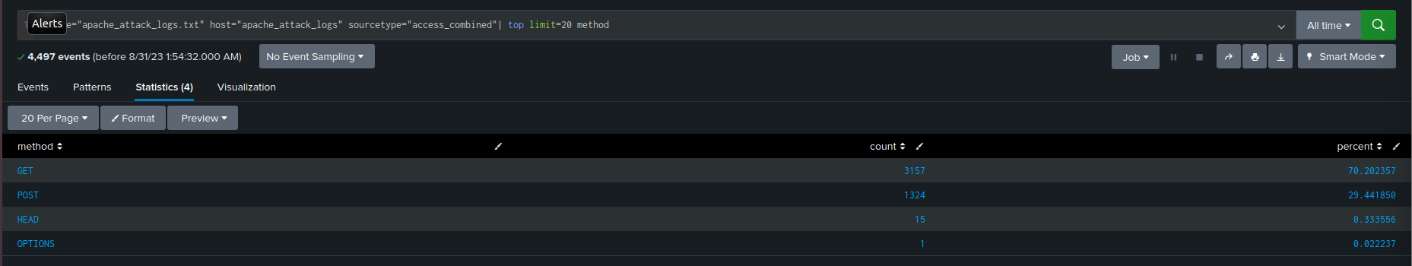
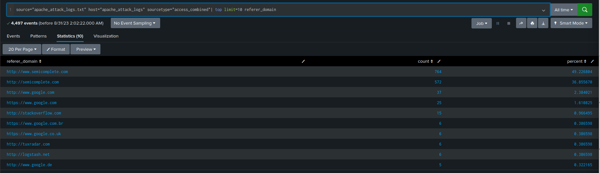
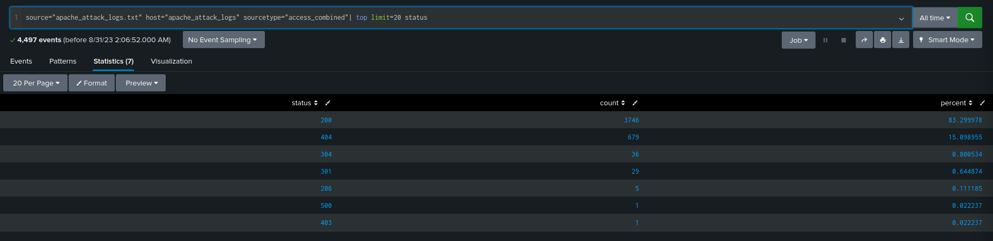
Screenshots of Attack Logs

Slide 36
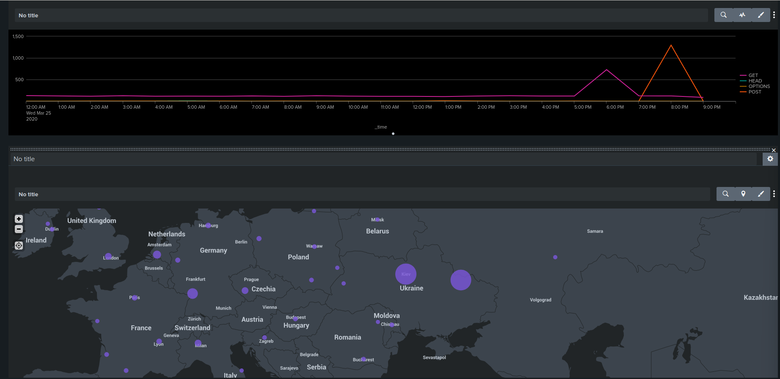
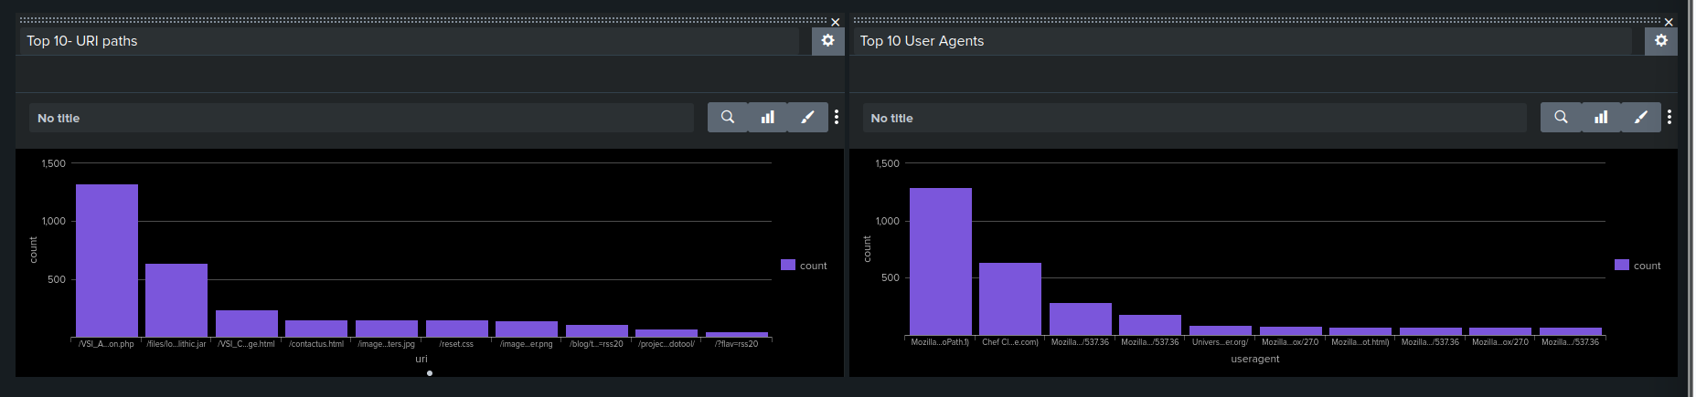
Screenshots of Attack Logs

Slide 37
Summary and Future Mitigations
‹#›

Slide 38
Project 3 Summary
What were your overall findings from the attack that took place?
It looks like an attack happened with the attack coming from Ukraine.
To protect VSI from future attacks, what future mitigations would you recommend?
Set a limit for failed logins so that it times out for them or temporarily blocking them if they continuously fail to login.

